Slide 1
Lab 1: Linked Lists

Slide 2
Outline
List and Node Classes
The Constructor
Simple Function Definitions
Push Front Definition
Pop Front Definition
Stepping through Linked Lists
The Destructor
Assignment and Copy Constructor
Summary

Slide 3
List and Node Classes
A linked list is a container where each object is stored in separate node
Each node must, in addition to storing an object, must also include a reference/pointer to the next node
  In C++, this is the address of the next node

Slide 4
List and Node Classes
We must dynamically create the nodes in a linked list
Thus, because new returns a pointer, the logical manner in which to track a linked lists is through a pointer
A Node class must store the data object and a reference to the next node (also a pointer)

Slide 5
The Node Class
The node must store an object and a pointer:
  In this case, the object is an integer
class Node {
private:
int element;
Node *next_node;
public:
Node( int = 0, Node * = 0 );
int retrieve() const;
Node *next() const;
};
  In Project 1, the type is given by the template:
    Object element;

Slide 6
The Node Class
The constructor assigns the two member variables based on the arguments
Node::Node( int e, Node *n ):element( e ), next_node( n ) {
// empty constructor
}
The default values for both arguments are both 0

Slide 7
The Node Class
The two member functions are accessors which simply return the element and the next_node member variables, respectively
int Node::retrieve() const {
return element;
}
Node *Node::next() const {
return next_node;
}

Slide 8
Project 1 – Creating your VS Project
Create a VS project name P1( type is c++, General)
Add source code provided for P1, in course web page.
  Start by solving part a) – Single List
  Files needed in the VS project :
    Ece250.h
    Exception.h
    Tester.h
    Single_list.h
    Single_node.h
    Single_node_tester.h
    Single_list_tester.h
    Single_list_driver.cpp
From Common Source Files

Slide 9
Project 1 – Creating your VS Project
Compile your VS Project as given. It should compile without errors.
Complete class Single_node.h
Questions about C++ syntax so far?
  Template classes
  Friend classes
  Constructor , initializing values

Slide 10
The List Class
Because each node in a linked list refers to the next, the linked list class needs to store the address of the first node
  This requires one member variable: a pointer to a node
class List {
private:
Node *list_head;
// ...
};

Slide 11
The List Class
This is the class definition:
class List {
private:
Node *list_head;
public:
List();
// Accessors
bool empty() const;
int front() const;
Node * head() const;
int count( int ) const;
// Mutators
void push_front( int );
int pop_front();
int erase( int );
};

Slide 12
The List Class
This is the class in your project 1 – very similar but not the same:
template <typename Object>
class Single_list {
private:
  Single_node<Object> *list_head;
  Single_node<Object> *list_tail; I
  int node_count;

Slide 13
Linked Lists in Memory
To begin, let us look at the internal representation of a linked list
Suppose we want a linked list to store the values
42 95 70 81
in this order
This could be the result of:
int main() {
List ls;
ls.push_front( 81 );
ls.push_front( 70 );
ls.push_front( 95 );
ls.push_front( 42 );
return 0;
}

Slide 14
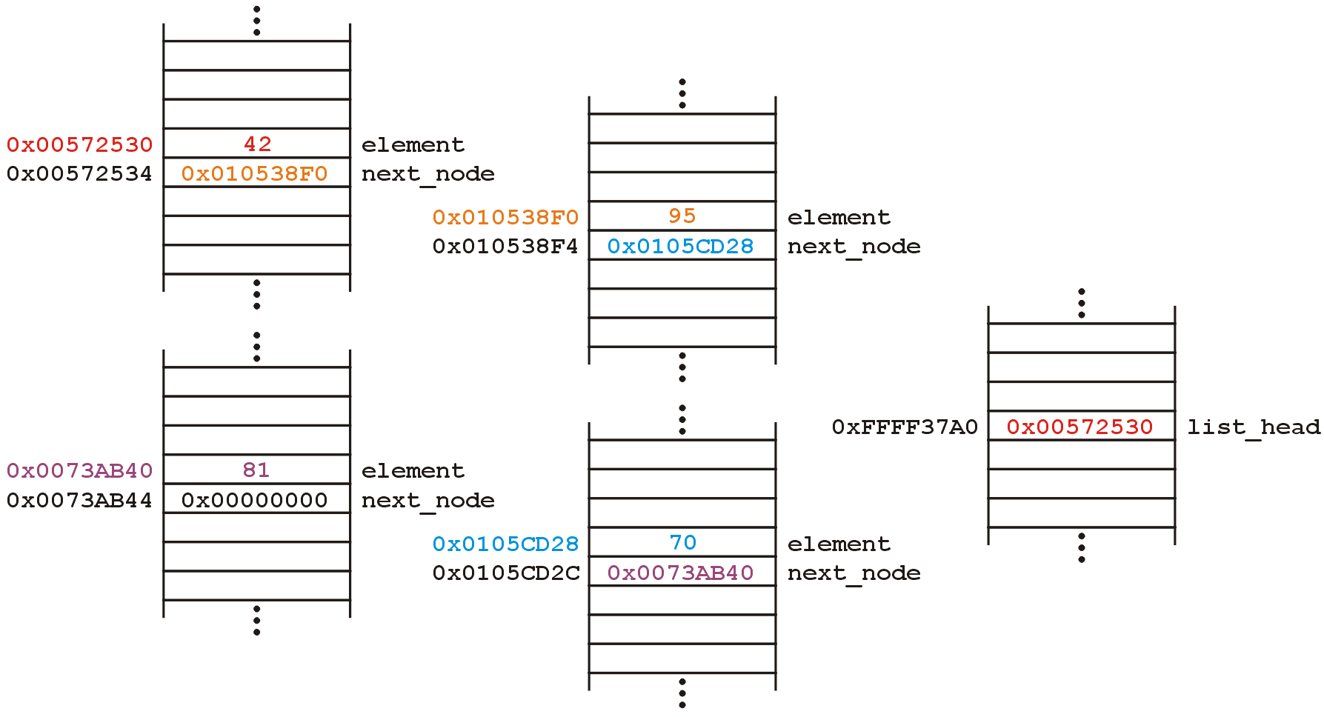
Linked Lists in Memory
These nodes could be stored anywhere in memory:
  For example,

Slide 15
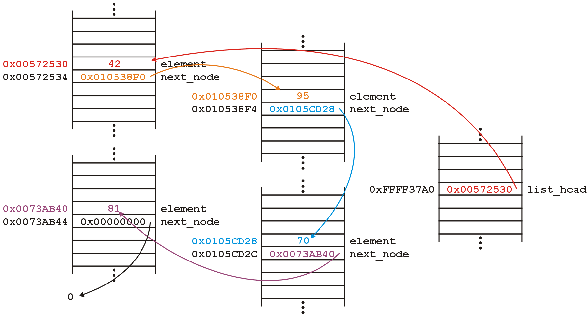
Linked Lists in Memory
Notice how each next_node address points to the next node in the list?

Slide 16
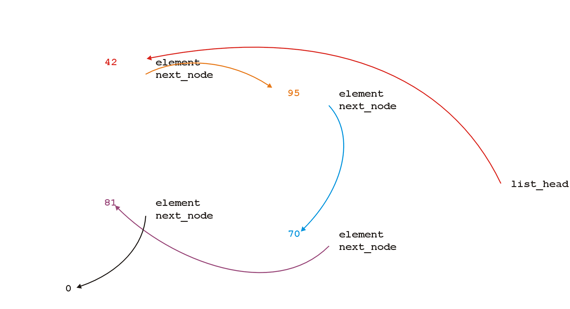
Linked Lists in Memory
Because the addresses are arbitrary, we can remove that information:

Slide 17
Linked Lists in Memory
We will clean up the representation as follows:
We do not specify the addresses because they are arbitrary and:
  The contents of the circle is the stored object
  The next_node pointer is represented by an arrow

Slide 18
Operations on Linked Lists
First, we want to create a linked list
We also want to be able to:
  Insert void push_front( int );
  Access int front() const;
  Node *head() const;
  Remove int pop_front();
the front object stored in the linked list
Operations on the entire linked list may include:
  Membership int count( int ) const;
  Erase an object int erase( int );
Additionally, we may wish to check the state: is the linked list empty?
  bool empty() const;

Slide 19
The Constructor
The constructor initializes the linked list
We do not count how may objects are in this list, thus:
  We must rely on the last pointer in the linked list to point to a special value
  In C++, we use 0 (the zero address)

Slide 20
The Constructor
Thus, in the constructor, we assign 0 to list_head:
List::List():list_head( 0 ) {
// empty constructor
}
We will always ensure that when a linked list is empty, the list head is assigned 0

Slide 21
Simple Function Definitions
Starting with the easier member functions:
bool List::empty() const {
if ( list_head == 0 ) {
return true;
} else {
return false;
}
}
or better yet:
bool List::empty() const {
return ( list_head == 0 );
}

Slide 22
Simple Function Definitions
The member function Node *head() const is easy enough to implement:
Node *List::head() const {
return list_head;
}
This will always work: if the list is empty, it will return 0

Slide 23
Simple Function Definitions
To get the first element in the linked list, we must access the node to which the list_head is pointing
Because we have a pointer, we must use the -> operator to call the member function:
int List::front() const {
return head()->retrieve();
}

Slide 24
Simple Function Definitions
The member function int front() const requires some additional consideration, however:
  What if the list is empty?
If we tried to access a member function of a pointer set to 0, we would access restricted memory
The operating system would terminate the running program

Slide 25
Simple Function Definitions
Instead, we can use an exception handling mechanism where we throw an exception
We define a class
class underflow {
// emtpy
};
and then we throw an instance of this class:
throw underflow();

Slide 26
Simple Function Definitions
Thus, the full function is
int List::front() const {
if ( empty() ) {
throw underflow();
}
return head()->retrieve();
}

Slide 27
Simple Function Definitions
Why is emtpy() better than
int List::front() const {
if ( list_head == 0 ) {
throw underflow();
}
return head()->retrieve();
}
?
Two benefits:
  more readable
  if the implementation changes we do nothing

Slide 28


Push Front Definition
Next, let us add an element to the list
If it is empty, we start with:
and, if we try to add 81, we should end up with:

Slide 29
Push Front Definition
To visualize what we must do:
  We must create a new node which stores:
    The value 81, and
    The address (pointer) 0
  We must then assign its address to list_head
We can do this as follows:
list_head = new Node( 81, 0 );
We could also use the default value...

Slide 30
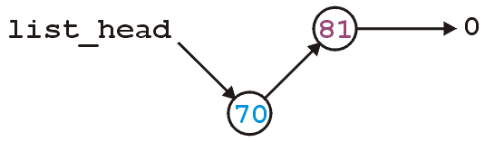
Push Front Definition
Suppose however, we already have a non-empty list
Adding 70, we want:

Slide 31
Push Front Definition
To achieve this, we must we must create a new node which stores:
    The value 70, and
    The address of the current list head
  We must then assign its address to list_head
We can do this as follows:
list_head = new Node( 70, list_head );

Slide 32
Push Front Definition
Thus, our implementation could be:
void List::push_front( int n ) {
if ( empty() ) {
list_head = new Node( n, 0 );
} else {
list_head = new Node( n, list_head );
}
}

Slide 33
Push Front Definition
We could, however, note that when the list is empty, list_head == 0, thus we could shorten this to:
void List::push_front( int n ) {
list_head = new Node( n, list_head );
}

Slide 34
Push Front Definition
Are we allowed to do this?
void List::push_front( int n ) {
list_head = new Node( n, list_head );
}
Yes: the right-hand side of an assignment statement is evaluated first
The original value of list_head is accessed first before the function call is made

Slide 35

Pop Front Definition
Removing from the linked list may appear easier:
  We simply assign the list head to the next pointer of the first node
Graphically, given:
we want:

Slide 36
Pop Front Definition
Easy enough:
int List::pop_front() {
list_head = list_head->next();
}
Unfortunately, we have some problems:
  We want to return the item stored
  The list may be empty
  We still have the memory allocated for the node containing 70

Slide 37
Pop Front Definition
We could try:
int List::pop_front() {
if ( empty() ) {
throw underflow();
}
int e = front();
delete list_head;
list_head = list_head -> next();
return e;
}
Let’s examine this...

Slide 38
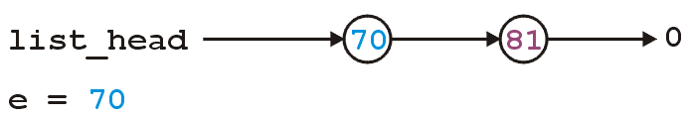
Pop Front Definition
int List::pop_front() {
if ( empty() ) {
throw underflow();
}
int e = front();
delete list_head;
list_head = list_head->next();
return e;
}

Slide 39
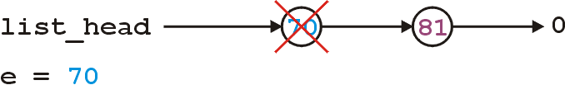
Pop Front Definition
int List::pop_front() {
if ( empty() ) {
throw underflow();
}
int e = front();
delete list_head;
list_head = list_head->next();
return e;
}

Slide 40
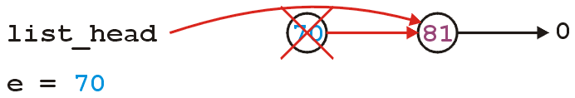
Pop Front Definition
int List::pop_front() {
if ( empty() ) {
throw underflow();
}
int e = front();
delete list_head;
list_head = list_head->next();
return e;
}

Slide 41
Pop Front Definition
The problem is, we are accessing a node which we have just deleted
Unfortunately, this will work more than 99% of the time:
  the running program (process) may still own the memory
Once in a while it will fail ...
... and it will be almost impossible to debug

Slide 42
Pop Front Definition
The correct implementation assigns a temporary pointer to point to the node being deleted:
int List::pop_front() {
if ( empty() ) {
throw underflow();
}
int e = front();
Node *ptr = list_head;
list_head = list_head->next();
delete ptr;
return e;
}

Slide 43
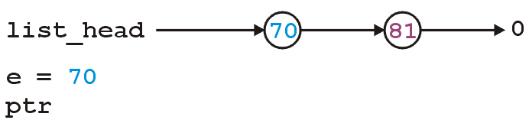
Pop Front Definition
int List::pop_front() {
if ( empty() ) {
throw underflow();
}
int e = front();
Node *ptr = list_head;
list_head = list_head->next();
delete ptr;
return e;
}

Slide 44
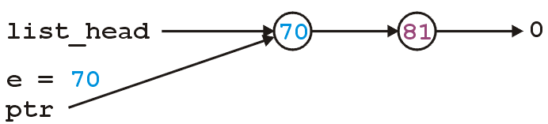
Pop Front Definition
int List::pop_front() {
if ( empty() ) {
throw underflow();
}
int e = front();
Node *ptr = list_head;
list_head = list_head->next();
delete ptr;
return e;
}

Slide 45
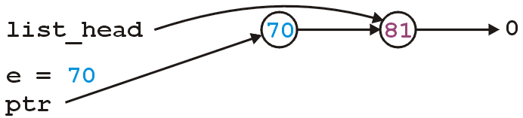
Pop Front Definition
int List::pop_front() {
if ( empty() ) {
throw underflow();
}
int e = front();
Node *ptr = list_head;
list_head = list_head->next();
delete ptr;
return e;
}

Slide 46
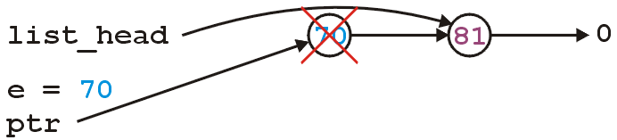
Pop Front Definition
int List::pop_front() {
if ( empty() ) {
throw underflow();
}
int e = front();
Node *ptr = list_head;
list_head = list_head->next();
delete ptr;
return e;
}

Slide 47
Project 1: Linked List – Accessors and push_front
Notice that the constructor is given to you
Complete accessors in class Single_list.h (except count)
        int size() const;
bool empty() const;
Object front() const;
Object back() const;
Single_node<Object> *head() const;
Single_node<Object> *tail() const;
Complete the mutator push_front
Test these functions using commands listed in Single_list_tester.h.

Slide 48
Testing
Test file with functions implemented so far, ie.
    new
    push_front 3
    push_front 7
    front 7
    back 3
    head
    retrieve 7
    next
    retrieve 3
    next0
    exit
    size 2
    empty 0
    Exit
Try command “cout” – to list the content of your list
Notice file int.in. If your code passes this test you have 50 % of the total mark.

Slide 49
Stepping through Linked Lists
The next step is to look at member functions which potentially require us to step through the entire list:
int count( int ) const;
int erase( int );
For count, we will return 1 if the object was found and 0 otherwise
For erase, we return 1 if the object was found and 0 otherwise and we will delete the node.

Slide 50
Stepping through Linked Lists
The process of stepping through a linked list can be thought of as being analogous to a for loop:
  We initialize a temporary pointer with the list head
  We continue iterating until the pointer equals 0
  With each step, we set the pointer to point to the next object

Slide 51
Stepping through Linked Lists
Thus, we have:
for ( Node *ptr = head(); ptr != 0; ptr = ptr->next() ) {
// Do something
// - use ptr->fn() to call member functions
// - use ptr->var to assign/access member variables
}

Slide 52
Stepping through Linked Lists
Analogously:
for ( Node *ptr = head(); ptr != 0; ptr = ptr->next() ) {
// do something
// use ptr->fn() to call member functions
// use ptr->var to assign/access member variables
}
for ( int i = 0; i < N; ++i ) {
// do something
}

Slide 53
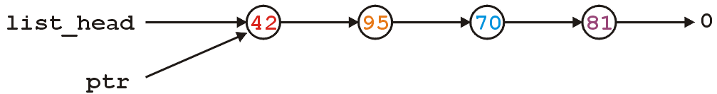
Stepping through Linked Lists
With the initialization and first iteration of the loop, we have:
ptr != 0 and thus we evaluate the body of the loop and then set ptr to the next node: ptr = ptr->next()
for ( Node *ptr = head(); ptr != 0; ptr = ptr->next() ) {
// Do something
}

Slide 54
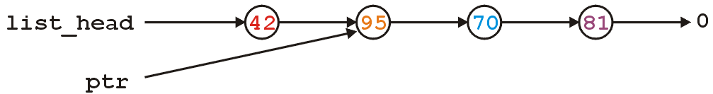
Stepping through Linked Lists
ptr != 0 and thus we evaluate the loop and increment the pointer
In the loop, we can access 95 by using ptr->retrieve()
for ( Node *ptr = head(); ptr != 0; ptr = ptr->next() ) {
// Do something
}

Slide 55
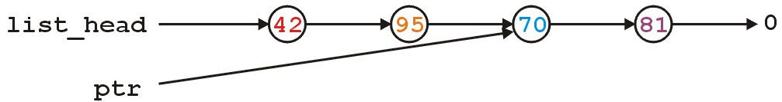
Stepping through Linked Lists
ptr != 0 and thus we evaluate the loop and increment the pointer
for ( Node *ptr = head(); ptr != 0; ptr = ptr->next() ) {
// Do something
}

Slide 56
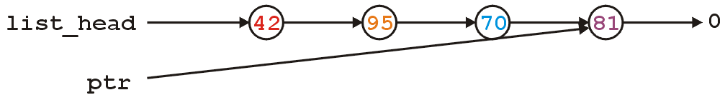
Stepping through Linked Lists
ptr != 0 and thus we evaluate the loop and increment the pointer
for ( Node *ptr = head(); ptr != 0; ptr = ptr->next() ) {
// Do something
}

Slide 57
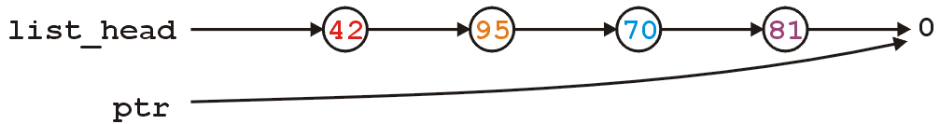
Stepping through Linked Lists
Here, we check and find ptr != 0 is false, and thus we exit the loop
Because the variable ptr was declared inside the loop, we can no longer access it
for ( Node *ptr = head(); ptr != 0; ptr = ptr->next() ) {
// Do something
}

Slide 58
Stepping through Linked Lists
To implement bool count(int) const;, we check if the argument matches the retrieved element with each step
  If we find the argument, we return true
  If we finish the loop, this indicates we did not find the argument: return false

Slide 59
Stepping through Linked Lists
The implementation:
int List::count( int n ) const {
for ( Node *ptr = head(); ptr != 0; ptr = ptr->next() ) {
if ( ptr->retrieve() == n ) {
return 1;
}
}
return 0;
}

Slide 60
Stepping through Linked Lists
To erase an arbitrary element, i.e., to implement int erase( int ), we must update the previous node
For example, given
if we delete 70, we want to end up with

Slide 61
Stepping through Linked Lists
Notice that the erase function must modify the member variables of the node prior to the node being removed
Thus, it must have access to the private instance variable next_node
We could supply the member function
void set_next( Node * );
however, this would be globally accessible

Slide 62
Stepping through Linked Lists
In Java/C#, you could define the Node class to be an inner class
  this is an elegant OO solution
In C++, you explicitly break encapsulation by declaring the class List to be a friend of the class Node:
class Node {
Node * next() const;
// ... declaration ...
friend class List;
};

Slide 63
Stepping through Linked Lists
Now, inside erase (a member function of List), you can modify all the member variables of any instance of the Node class
  Challenge for erase: you will need an additional temporary pointer when removing a node—once you update the linked list, you must delete the removed node

Slide 64
The Destructor
We dynamically allocated memory each time we added a new Node into this list
Suppose we delete a list before it is empty
  By default, this does not clean up any of those remaining nodes
Thus, we need to define a destructor:
class List {
private:
Node *list_head;
public:
List();
~List();
// ...etc...
};

Slide 65
The Destructor
The destructor has to delete any memory which was allocated with new but not yet deallocated
This is straight-forward enough:
while ( !empty() ) {
pop_front();
}
The overhead of pop_front is negligible when compared to calling delete

Slide 66
Project 1: count, erase and destructor
Complete count
Test
Complete pop_front
Complete erase, and destructor
Test

Slide 67
Assignment and Copy Constructor
We now have the functionality of the linked list class
However, there are other functional operations required for linked lists to interact with C++
Recall two common C++ operations:
  Assignment
  Passing by value (the copy constructor)

Slide 68
Assignment and Copy Constructor
Suppose you have two objects, be they linked lists or otherwise, for example:
List lst1;
List lst2;
lst1.push_front( 35 );
lst1.push_front( 18 );
lst2.push_front( 94 );
lst2.push_front( 72 );

Slide 69
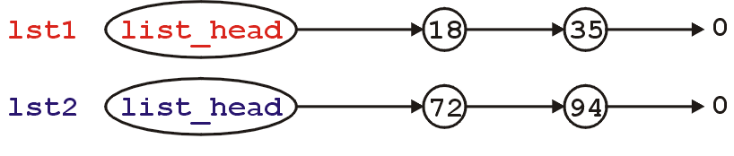
Assignment and Copy Constructor
This is the current state:
If we assign
lst2 = lst1;
by default, all that occurs is that the member variables from lst1 are copied to the member variables of lst2

Slide 70
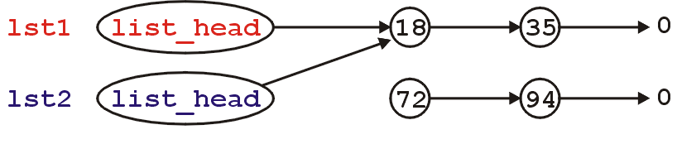
Assignment and Copy Constructor
Because the only member variable of this class is list_head, the value it is storing (the address of the first node) is copied over
It is equivalent to writing:
lst2.list_head = lst1.list_head;
Graphically:

Slide 71
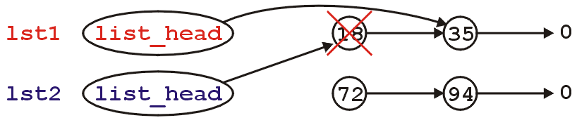
Assignment and Copy Constructor
What’s wrong with this picture?
  We no longer have links to either of the nodes storing 72 or 94
  Also, suppose we call the member function
  lst1.pop_front();
  This only affects the member variable from the object lst1
  Thus, we go from
  to

Slide 72
Assignment and Copy Constructor
Now, the second list lst2 is pointing to memory which has been deallocated...
What is the behavior is we call
lst2.pop_front();
?
The behaviour is undefined, however, soon this will probably lead to an access violation

Slide 73
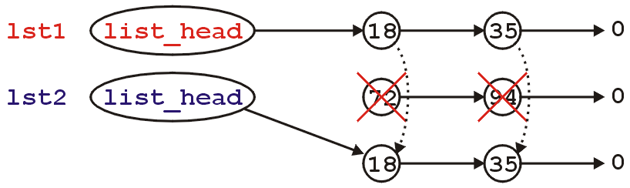
Assignment and Copy Constructor
We need to properly implement assignment
The logical solution would be to:
  Delete all the nodes in lst2
  Copy all of the nodes in lst1 to lst2
  Thus, we go from
  to

Slide 74
Assignment and Copy Constructor
To define assignment, we must overload the function named operator=
  This is a how you indicate to the compiler that you are overloading the = operator
Its signature is:
List &operator=( List const & );
To avoid copies, the argument and return value are passed by reference
List &operator=( const List &rhs );
Because it is a reference, that means that you must refer use, for example, rhs.head() or rhs.push_front()

Slide 75
Assignment and Copy Constructor
Because we are overwriting the current object, we must:
List &operator=( List const &rhs ) {
// clean up this object
// make a complete copy of rhs
return *this;
}
Here, the name of the argument rhs refers to the right-hand side of the assignment

Slide 76
Assignment and Copy Constructor
To clean up the current linked list, we need to remove all nodes in this linked list:
List &operator=( List const &rhs ) {
while ( !empty() ) {
pop_front();
}
// Make a complete copy of rhs
return *this;
}

Slide 77
Assignment and Copy Constructor
However, we have a problem: consider
List a;
a.push_front( 3 );
a = a;
List &operator= ( const List &rhs ) {
while ( !empty() ) {
pop_front();
}
// Both rhs and *this refer to the same
// linked list which is now empty
// Make a complete copy of rhs
return *this;
}

Slide 78
Assignment and Copy Constructor
To avoid this problem, we must always make the following check:
List &operator= ( const List &rhs ) {
if ( this == &rhs ) {
return *this; // No copy is necessary
}
while ( !empty() ) {
pop_front();
}
// Make a complete copy of rhs
return *this;
}

Slide 79
Assignment and Copy Constructor
To make a copy of the right hand side is a little more difficult...
We must step through the second linked list and create a new node for each object in the rhs list

Slide 80
Assignment and Copy Constructor
List &List::operator= ( const List &rhs ) {
while ( !empty() ) {
pop_front();
}
if ( rhs.empty() ) {
return * this;
}
list_head = new Node( rhs.front() ); // copy the front element
for ( Node * lhptr = head(), * rhptr = rhs.head();
rhptr -> next() != 0;
rhptr = rhptr -> next(), lhptr = lhptr -> next()
) {
lhptr -> next_node = new Node( rhptr -> next() -> retrieve() );
}
return * this;
}

Slide 81
Assignment and Copy Constructor
Visually, we are doing the following:
In assigning lst2 = lst1;

Slide 82
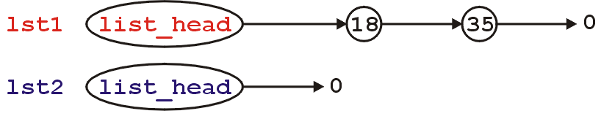
Assignment and Copy Constructor
Empty the second list:

Slide 83
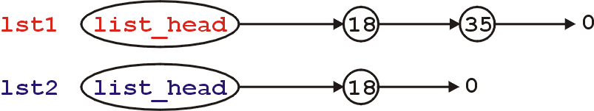
Assignment and Copy Constructor
If the 1st list is not empty, push the front element of the 1st list onto the 2nd list:

Slide 84
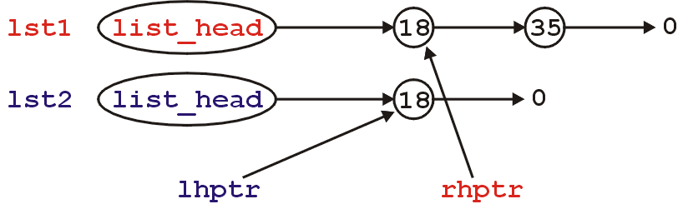
Assignment and Copy Constructor
Get two pointers pointing to the first nodes in each of the lists

Slide 85
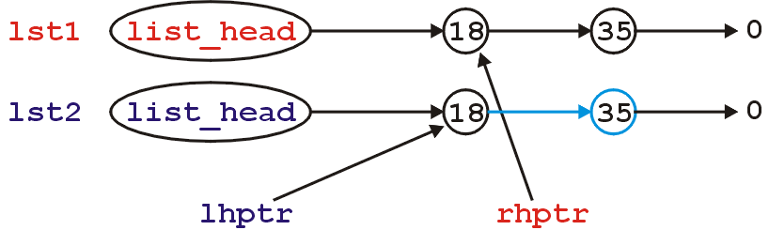
Assignment and Copy Constructor
While there is a node following the node pointed to by rhptr, add that node to the 2nd list:

Slide 86
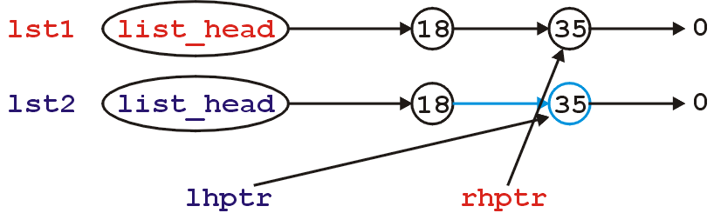
Assignment and Copy Constructor
Then, increment each of the pointers and continue repeating this procedure until there are no more nodes to add

Slide 87
Assignment and Copy Constructor
Because in Project 1, you have a tail pointer, you can actually do this a lot more easily
Like the member function, step through the first linked list, however, just call push_back( ptr -> retrieve() ) with node in the list

Slide 88
Assignment and Copy Constructor
Why do we return *this?
Suppose you have the assignment:
  lst3 = lst2 = lst1;
The assignment operator is right associative: it first evaluates lst2 = lst1;
After this, it must assign lst3 = ?;
? is whatever is returned by the assignment operation of lst2 = lst1;

Slide 89
Assignment and Copy Constructor
We have discussed assignment
We must now look at a similar problem:
  Making a copy of an already-existing object (Ex1 and Ex2 below)
  Passing or returning by value
These are the same problem: an object is being constructed and initialized with the value of another.
Ex1. Ex2.
List ls1;
Ls1.push_front(57);
List ls2( ls1 );
List ls1;
Ls1.push_front(57);
List ls2 = ls1;

Slide 90
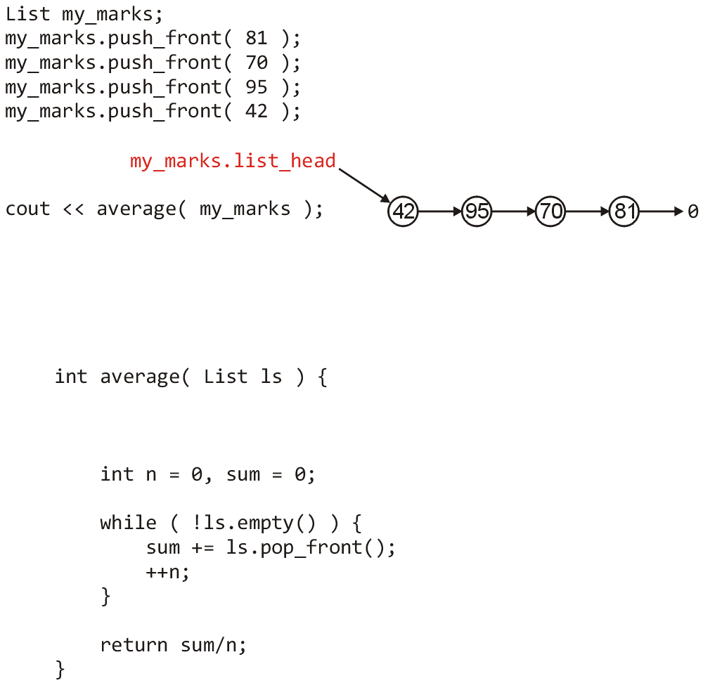
Assignment and Copy Constructor
Consider this
example where a
linked list is passed
to a function:
  Four values are
  stored in the list

Slide 91
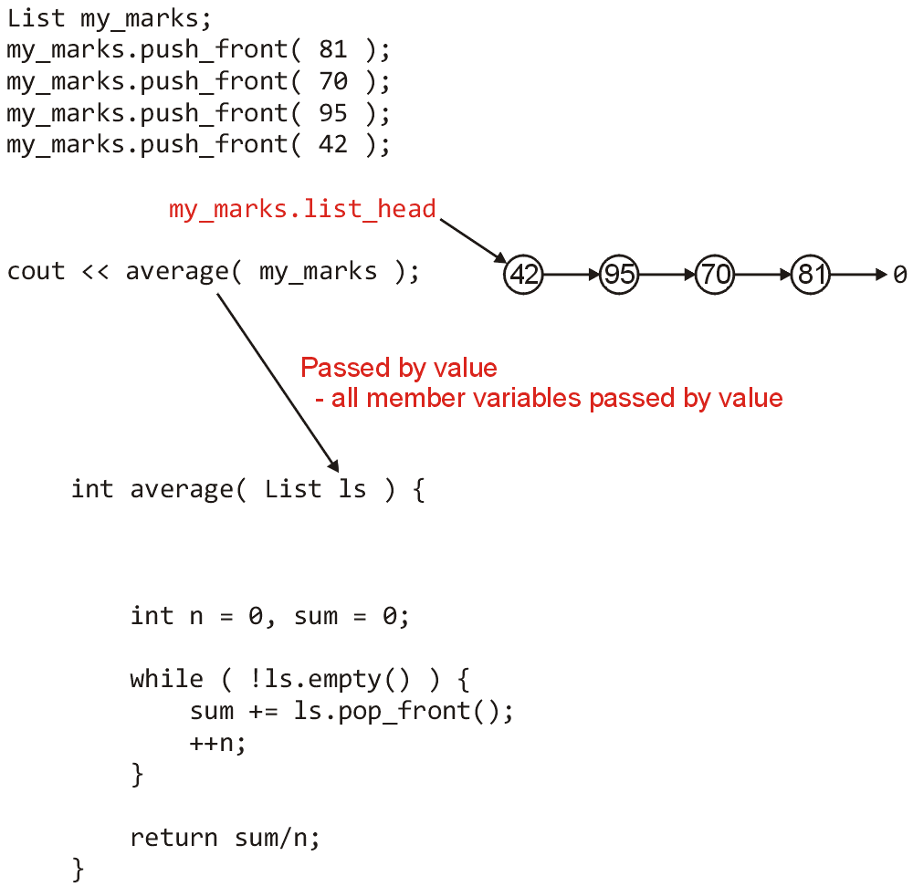
Assignment and Copy Constructor
By default, pass by
value copies values
  This includes all member
  variables are copied
  down including
  pointers which are just
  addresses

Slide 92
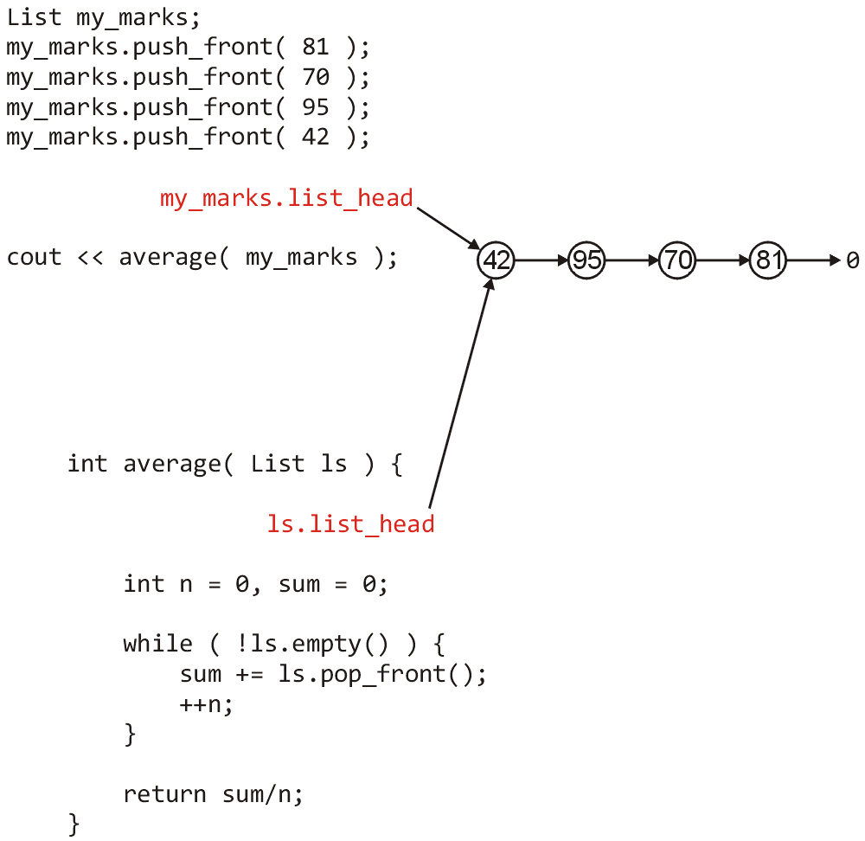
Assignment and Copy Constructor
Now we have two
objects which store
the same address in
the member variable
list_head

Slide 93
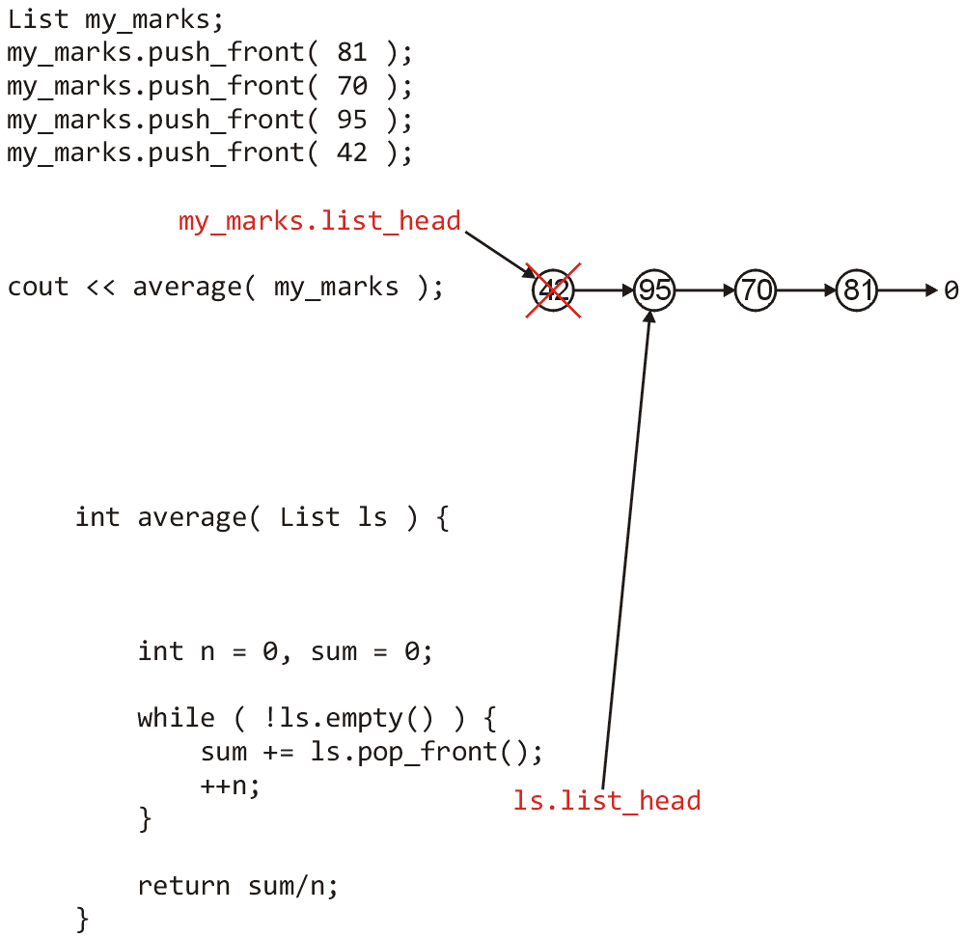
Assignment and Copy Constructor
After one iteration
of the loop, the
pop_front function
is called which
deletes the first node

Slide 94
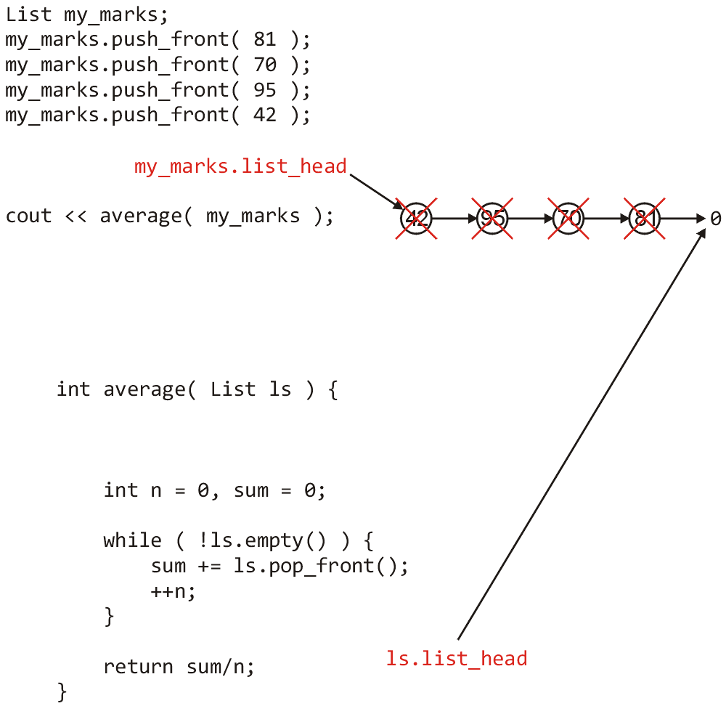
Assignment and Copy Constructor
At the end of the
function, all nodes
have been deleted

Slide 95
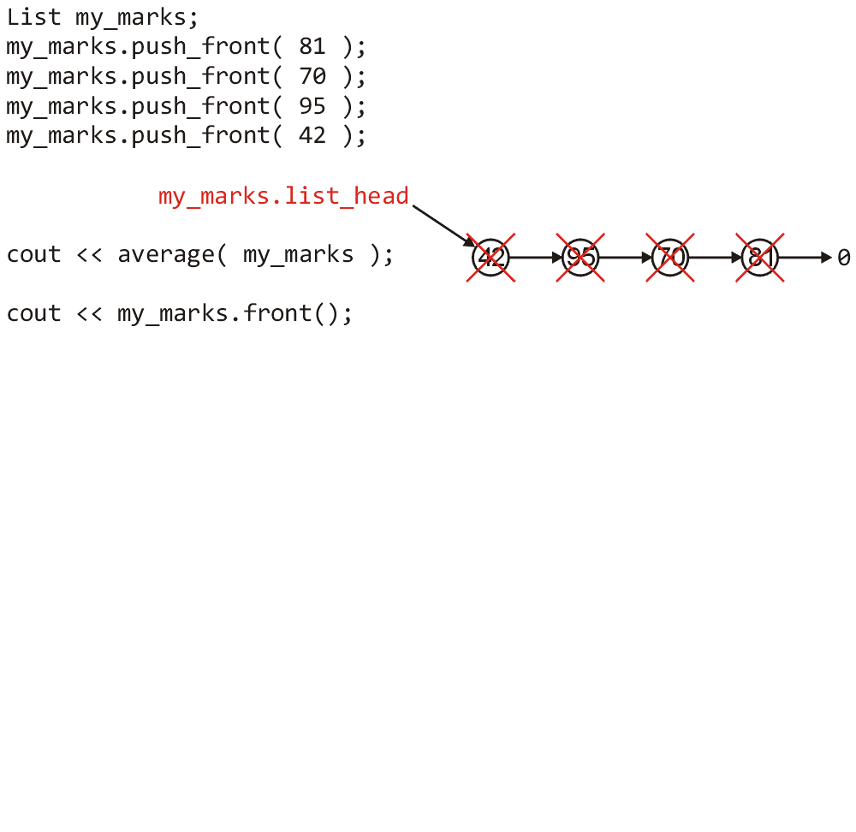
Assignment and Copy Constructor
If, in the original
function we now
attempt to access
a node, it no
longer exists

Slide 96
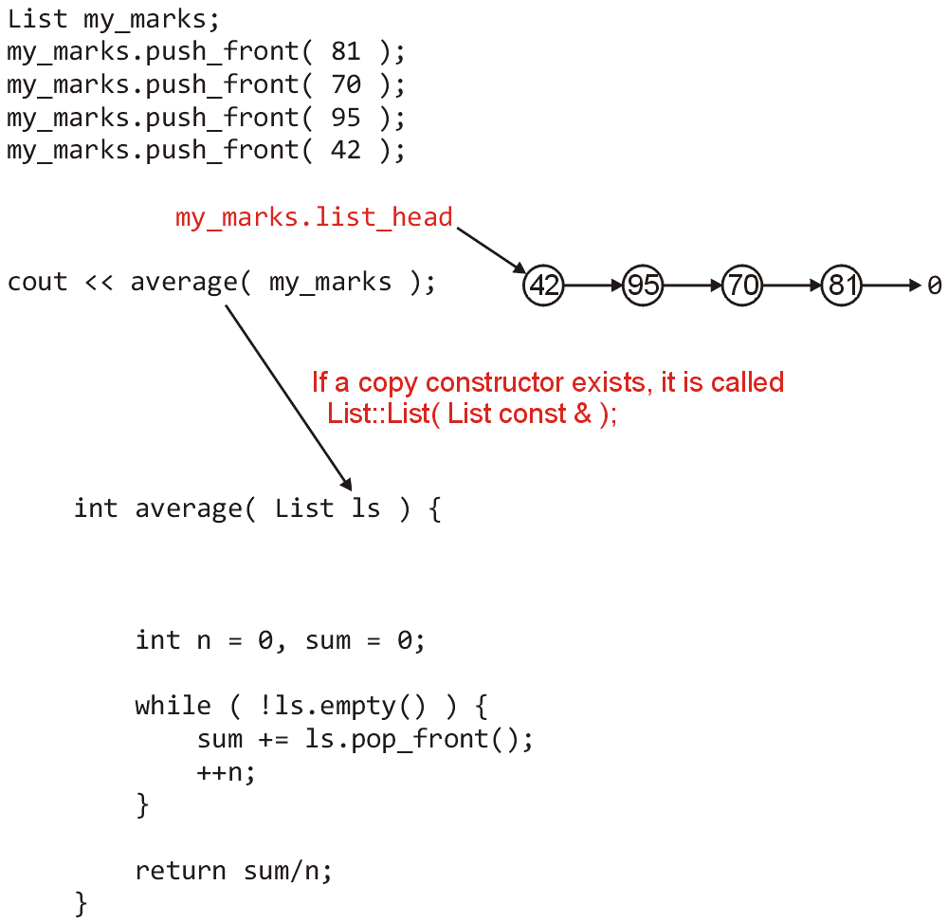
Assignment and Copy Constructor
We can, however,
define a copy
constructor
  This function is
  called whenever a copy
  of the object is being
  made

Slide 97
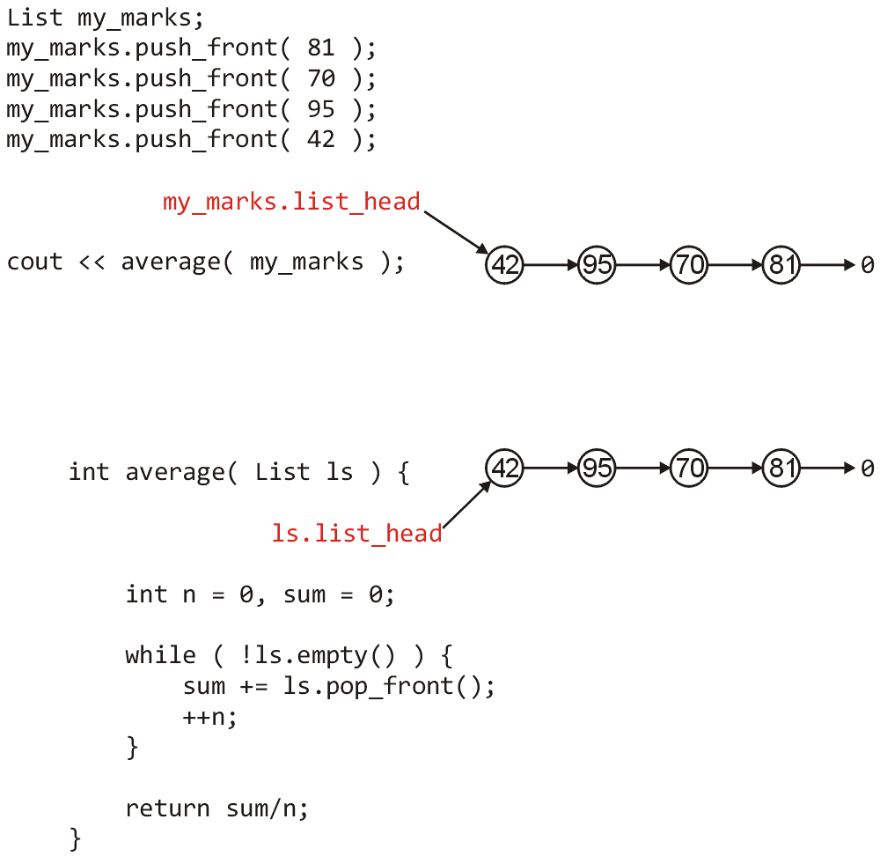
Assignment and Copy Constructor
In this case, the
copy constructor
should make a copy
of all four nodes

Slide 98
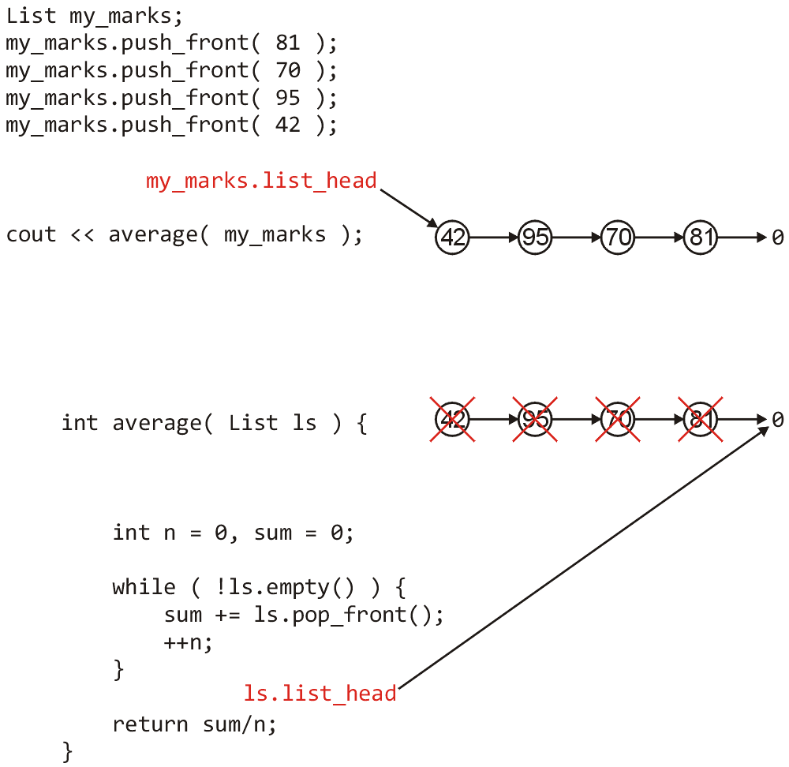
Assignment and Copy Constructor
Any changes made
to this copy do not
affect the original
linked list

Slide 99
Assignment and Copy Constructor
Thus, we require a copy constructor
This is a method called when an object is being copied, either as a result of being passed-by-value to a function or being returned-by-value from a function
Like a constructor, you should assume the variables are not initialized
Unlike a constructor, you are not passed arguments to the constructor, rather, you are passed a reference to the object which should be copied

Slide 100
Assignment and Copy Constructor
The signature of a copy constructor has a constant reference to the same class as an argument:
List( const List & );
The implementation of the copy constructor is almost identical to that of the operator =, except you are starting with a fresh object

Slide 101
Assignment and Copy Constructor
One simple implementation of a copy constructor is:
List::List( const List & lst ):list_head(0) {
*this = lst;
}
Here, all we do is:
  initialize the array (set list_head to 0), and
  let operator = do all the work

Slide 102
Summary
First, things to remember:
  In C++, a member function and a member variable cannot have the same name
  Common mistakes:
  ptr->retrieve;
  list->head;
Today, we looked at an example of a linked list implementation.

Slide 103
Summary
The Linked List example included
  An overview of the list and node classes
  Operations on linked lists
    The default constructor
    Getting started by coding simple functions
    Implementing push front and pop front functions
    Functions that require stepping through linked lists
    The required behavior of the list destructor
    The default and required behavior of operator=
    The need for a copy constructor

Slide 104
Summary
The complete class is:
class List {
private:
Node * list_head;
public:
List();
List( const List & );
~List();
List & operator = ( const List & );
bool empty() const;
int front() const;
Node * head() const;
int count( int ) const;
void push_front( int );
int pop_front();
int remove( int );
};

Slide 105
Project 1: assignment operator and copy constructor
Complete = operator
Complete copy constructor
Test

Slide 106

Usage Notes
These slides are made publicly available on the web for anyone to use
If you choose to use them, or a part thereof, for a course at another institution, I ask only three things:
  that you inform me that you are using the slides,
  that you acknowledge my work, and
  that you alert me of any mistakes which I made or changes which you make, and allow me the option of incorporating such changes (with an acknowledgment) in my set of slides
  Sincerely,
  Douglas Wilhelm Harder, MMath
  dwharder@alumni.uwaterloo.ca

